Slide 1
The NOMAD Centre of Excellence
NOMAD Repository since 2014, NOMAD CoE since 2015
NOMAD CoE receives funding from the European Union’s Horizon program under the grant agreement Nº 951786.

Slide 2
On the upper right side you will often see the logo of the Max Planck Society. Please feel free to replace this by the logo of your institute.

Slide 3
The NOMAD Centre of Excellence
NOMAD Repository since 2014, NOMAD CoE since 2015
Next level started October 2020
NOMAD CoE receives funding from the European Union’s Horizon program under the grant agreement Nº 951786.

Slide 4
Scope of NOMAD CoE
The Novel Materials Discovery (NOMAD) CoE
The NOMAD Centre of Excellence
Brief Summary of Concept, Structure, and Planned Work
The NOMAD CoE will assess and exploit the characteristics of next generation HPC for ab initio computational materials science, to enable investigations of systems of higher complexity (space and time), consideration of metastable states and temperature, and all this at significantly higher accuracy and precision than what is possible today.*
(*) This was suggested/requested by our industrial advisory board and second shell.
NOMAD CoE receives funding from the European Union’s Horizon program under the grant agreement Nº 951786.

Slide 5
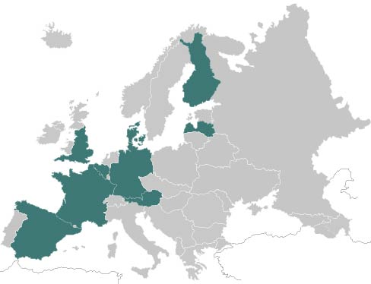
The NOMAD CoE Consortium
LATVIJAS UNIVERSITATE (LU)
TIETEEN TIETOTEKNIIKAN KESKUS OY (CSC)
AALTO UNIVERSITY HELSINKI (AALTO)
LATVIJAS UNIVERSITATE (LU)
DANMARKS TEKNISKE UNIVERSITET (DTU)
UNIVERSITE CATHOLIQUE DE LOUVAIN (UCL)
HUMBOLDT-UNIVERSITÄT ZU BERLIN (HUB)
THE UNIVERSITY OF WARWICK (WAR)
MAX PLANCK SOCIETY
Fritz Haber Institute (coordinator)
MPCDF
UNIVERSITY OF CAMBRIDGE (CAM)
COMMISSARIAT A L’ENERGIE ATOMIQUE ET AUX ENERGIES ALTERNATIVES (CEA)
TECHNISCHE UNIVERSITÄT WIEN (TUW)
BARCELONA
SUPERCOMPUTING CENTER - (BSC)
NOMAD CoE receives funding from the European Union’s Horizon program under the grant agreement Nº 951786.

Slide 6
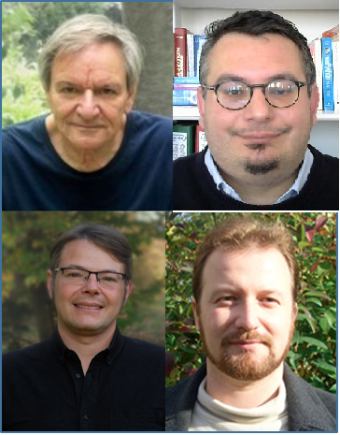
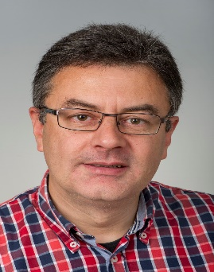
The NOMAD CoE Team
The NOMAD CoE Team
MPS - FHI
HUB
MPS - MPCDF
BSC
Aalto
CSC
Coordinator
Deputy-Coordinator
Assistant
Matthias Scheffler
Gabriele
Mogni
Claudia
Draxl
Erwin
Laure
Hermann Lederer
Jose Maria
Cela
Patrick
Rinke
Jussi Heikonen
Kimmo
Koski
Christian Carbogno
Luca
Ghiringhelli
Markus Scheidgen
Markus Rampp
Andreas Marek
Albert
Farres
Jussi
Enkovaara
UCL
DTU
LU
WAR
CEA
TUW
CAM
Xavier Gonze
Geoffroy Hautier
Gian-Marco
Rignanese
Kristian
Thygesen
Andris Gulans
James
Kermode
Marc
Torrent
Andreas
Grüneis
Gábor
Csányi
NOMAD CoE receives funding from the European Union’s Horizon program under the grant agreement Nº 951786.

Slide 7
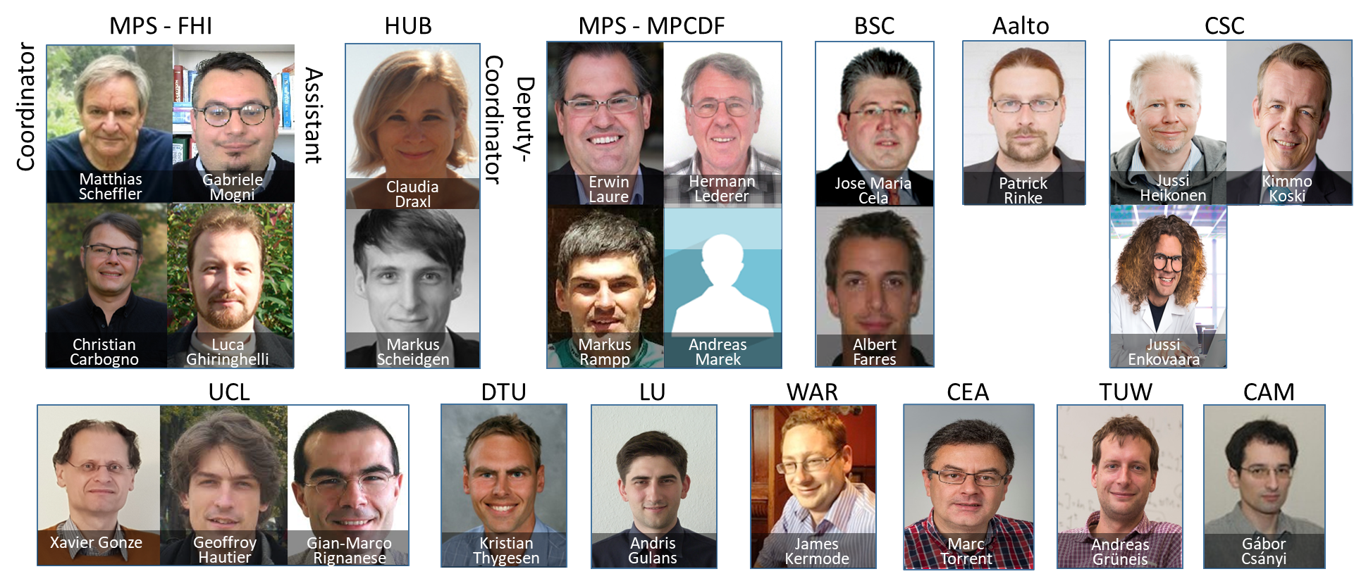
The NOMAD CoE Team
The NOMAD CoE Team
As well as several PhD students and postdocs
NOMAD CoE receives funding from the European Union’s Horizon program under the grant agreement Nº 951786.

Slide 8
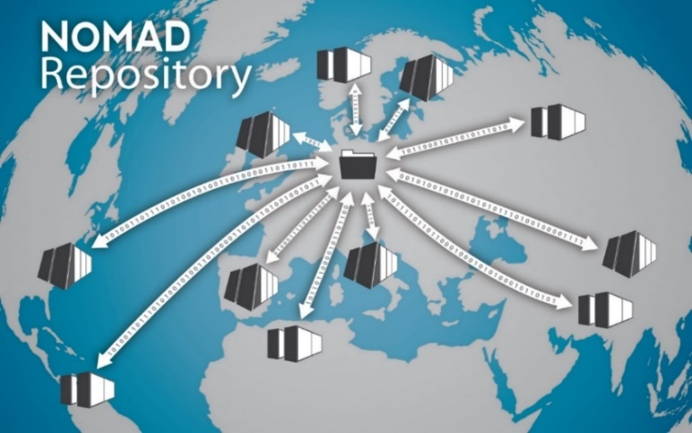
The NOMAD Centre of Excellence
The NOMAD Centre of Excellence
since 2014
Since 2014
Since 2014
September 2020
The biggest data store in computational materials science.
Data are Findable and AI Ready ( = advanced interpretation of the acronym FAIR).
Develop exascale-ready libraries to the benefit of the entire community.
NOMAD CoE receives funding from the European Union’s Horizon program under the grant agreement Nº 951786.

Slide 9
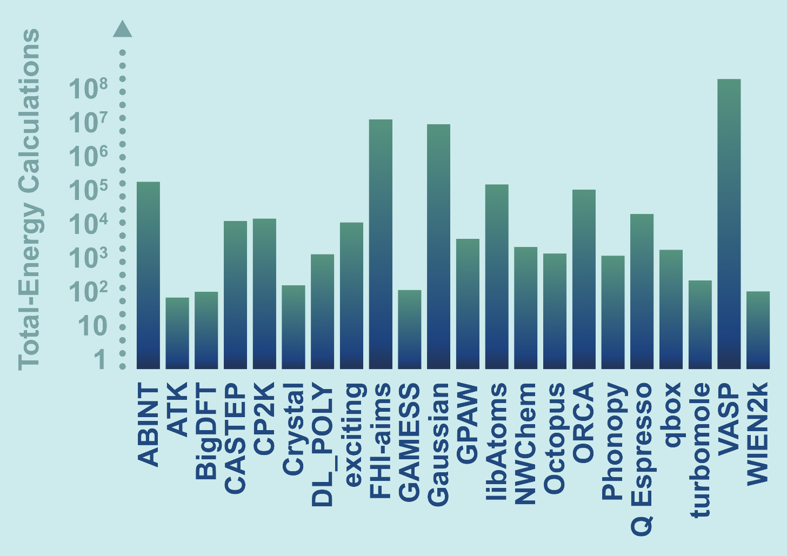
The Ecosystem of Ab Initio Software
Calculations produced by 40 different codes
More than 100 mio total-energy calculations
(billions of CPU core hours at HPC centers worldwide)
How to take them to the exascale?
NOMAD CoE receives funding from the European Union’s Horizon program under the grant agreement Nº 951786.

Slide 10
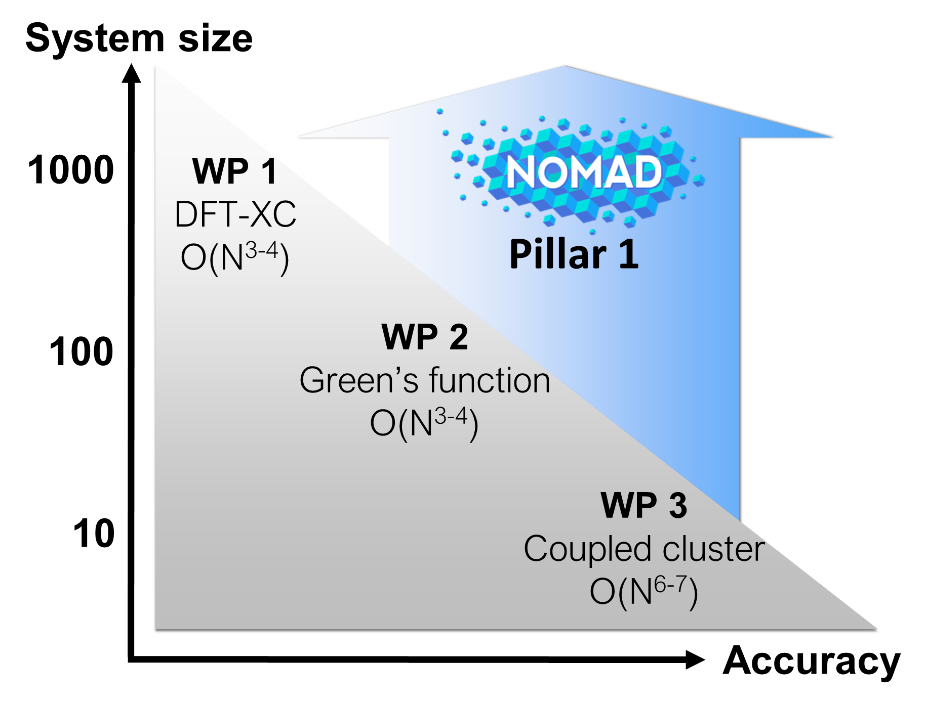
Challenges
We tackle most modern and computationally most demanding methodology with highest accuracy to address future-oriented research problems
Scaling of various methods and system size (#of atoms) currently possible
NOMAD CoE receives funding from the European Union’s Horizon program under the grant agreement Nº 951786.

Slide 11
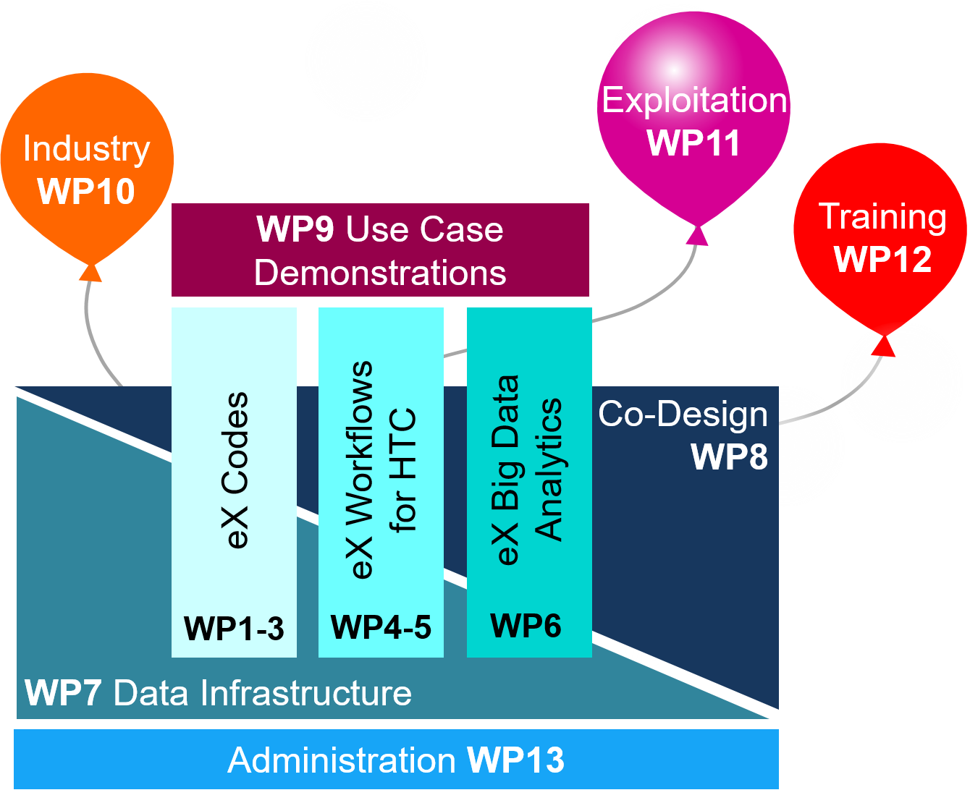
Organization in Pillars and Work Packages
The pillars develop exascale…
Codes (WP1-3)
for all code families
Workflows (WP4-5)
Big Data AI analytics (WP6)
All offered as libraries.
Finally demonstrated by two use cases (WP9) from urgent energy and environmental research: water splitting and thermoelectrics.
NOMAD CoE receives funding from the European Union’s Horizon program under the grant agreement Nº 951786.

Slide 12
Title
NOMAD CoE receives funding from the European Union’s Horizon program under the grant agreement Nº 951786.

Slide 13
Title
NOMAD CoE receives funding from the European Union’s Horizon program under the grant agreement Nº 951786.

